Slide 1
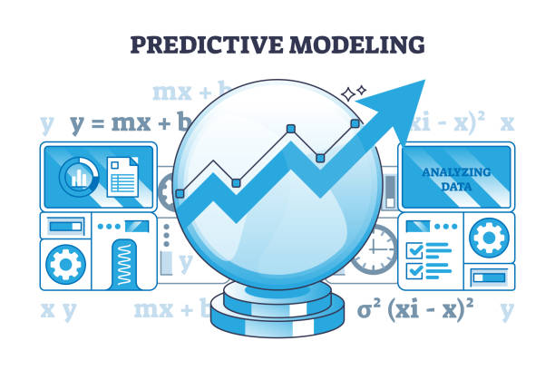
Predictive Modeling
Priyanshu Goswami
Data Engineers Intern, Hackveda
Date:- 13 November 2024

Slide 2
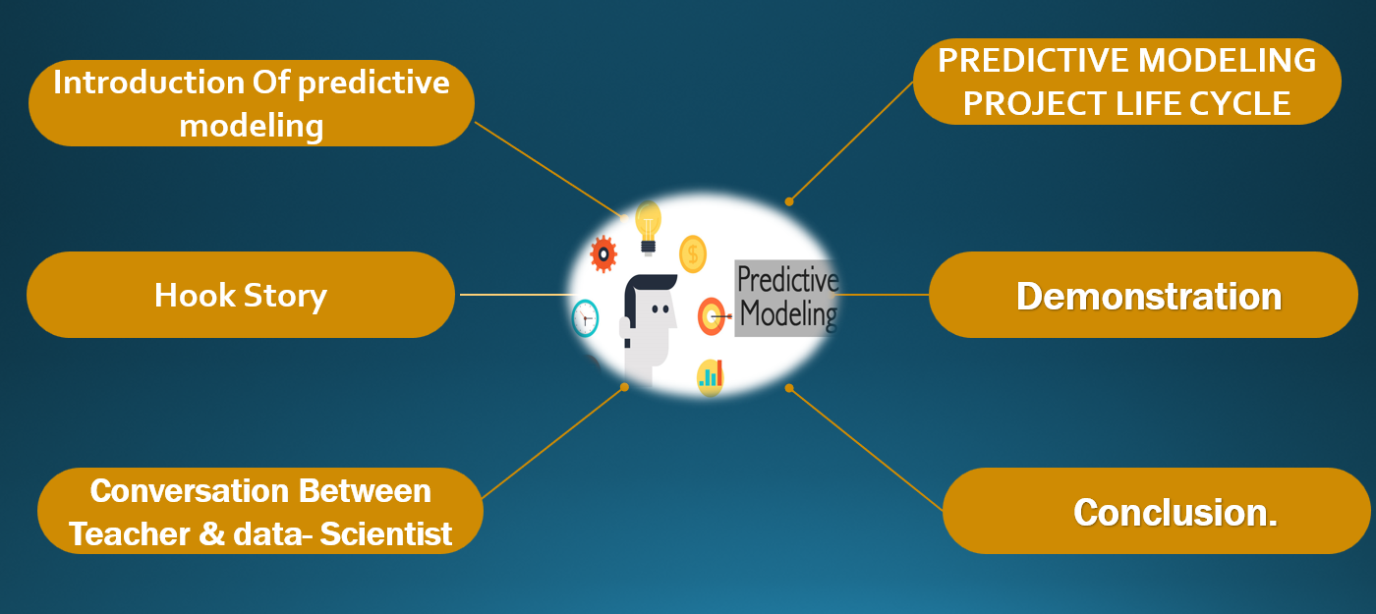
Overview:-

Slide 3
Introduction Of predictive modeling:-
Predictive modeling refers to the process of using data mining and statistical techniques to predict future events or behaviors. By analyzing patterns in existing data, predictive models can identify trends and make informed predictions about unknown or future data points.

Slide 4

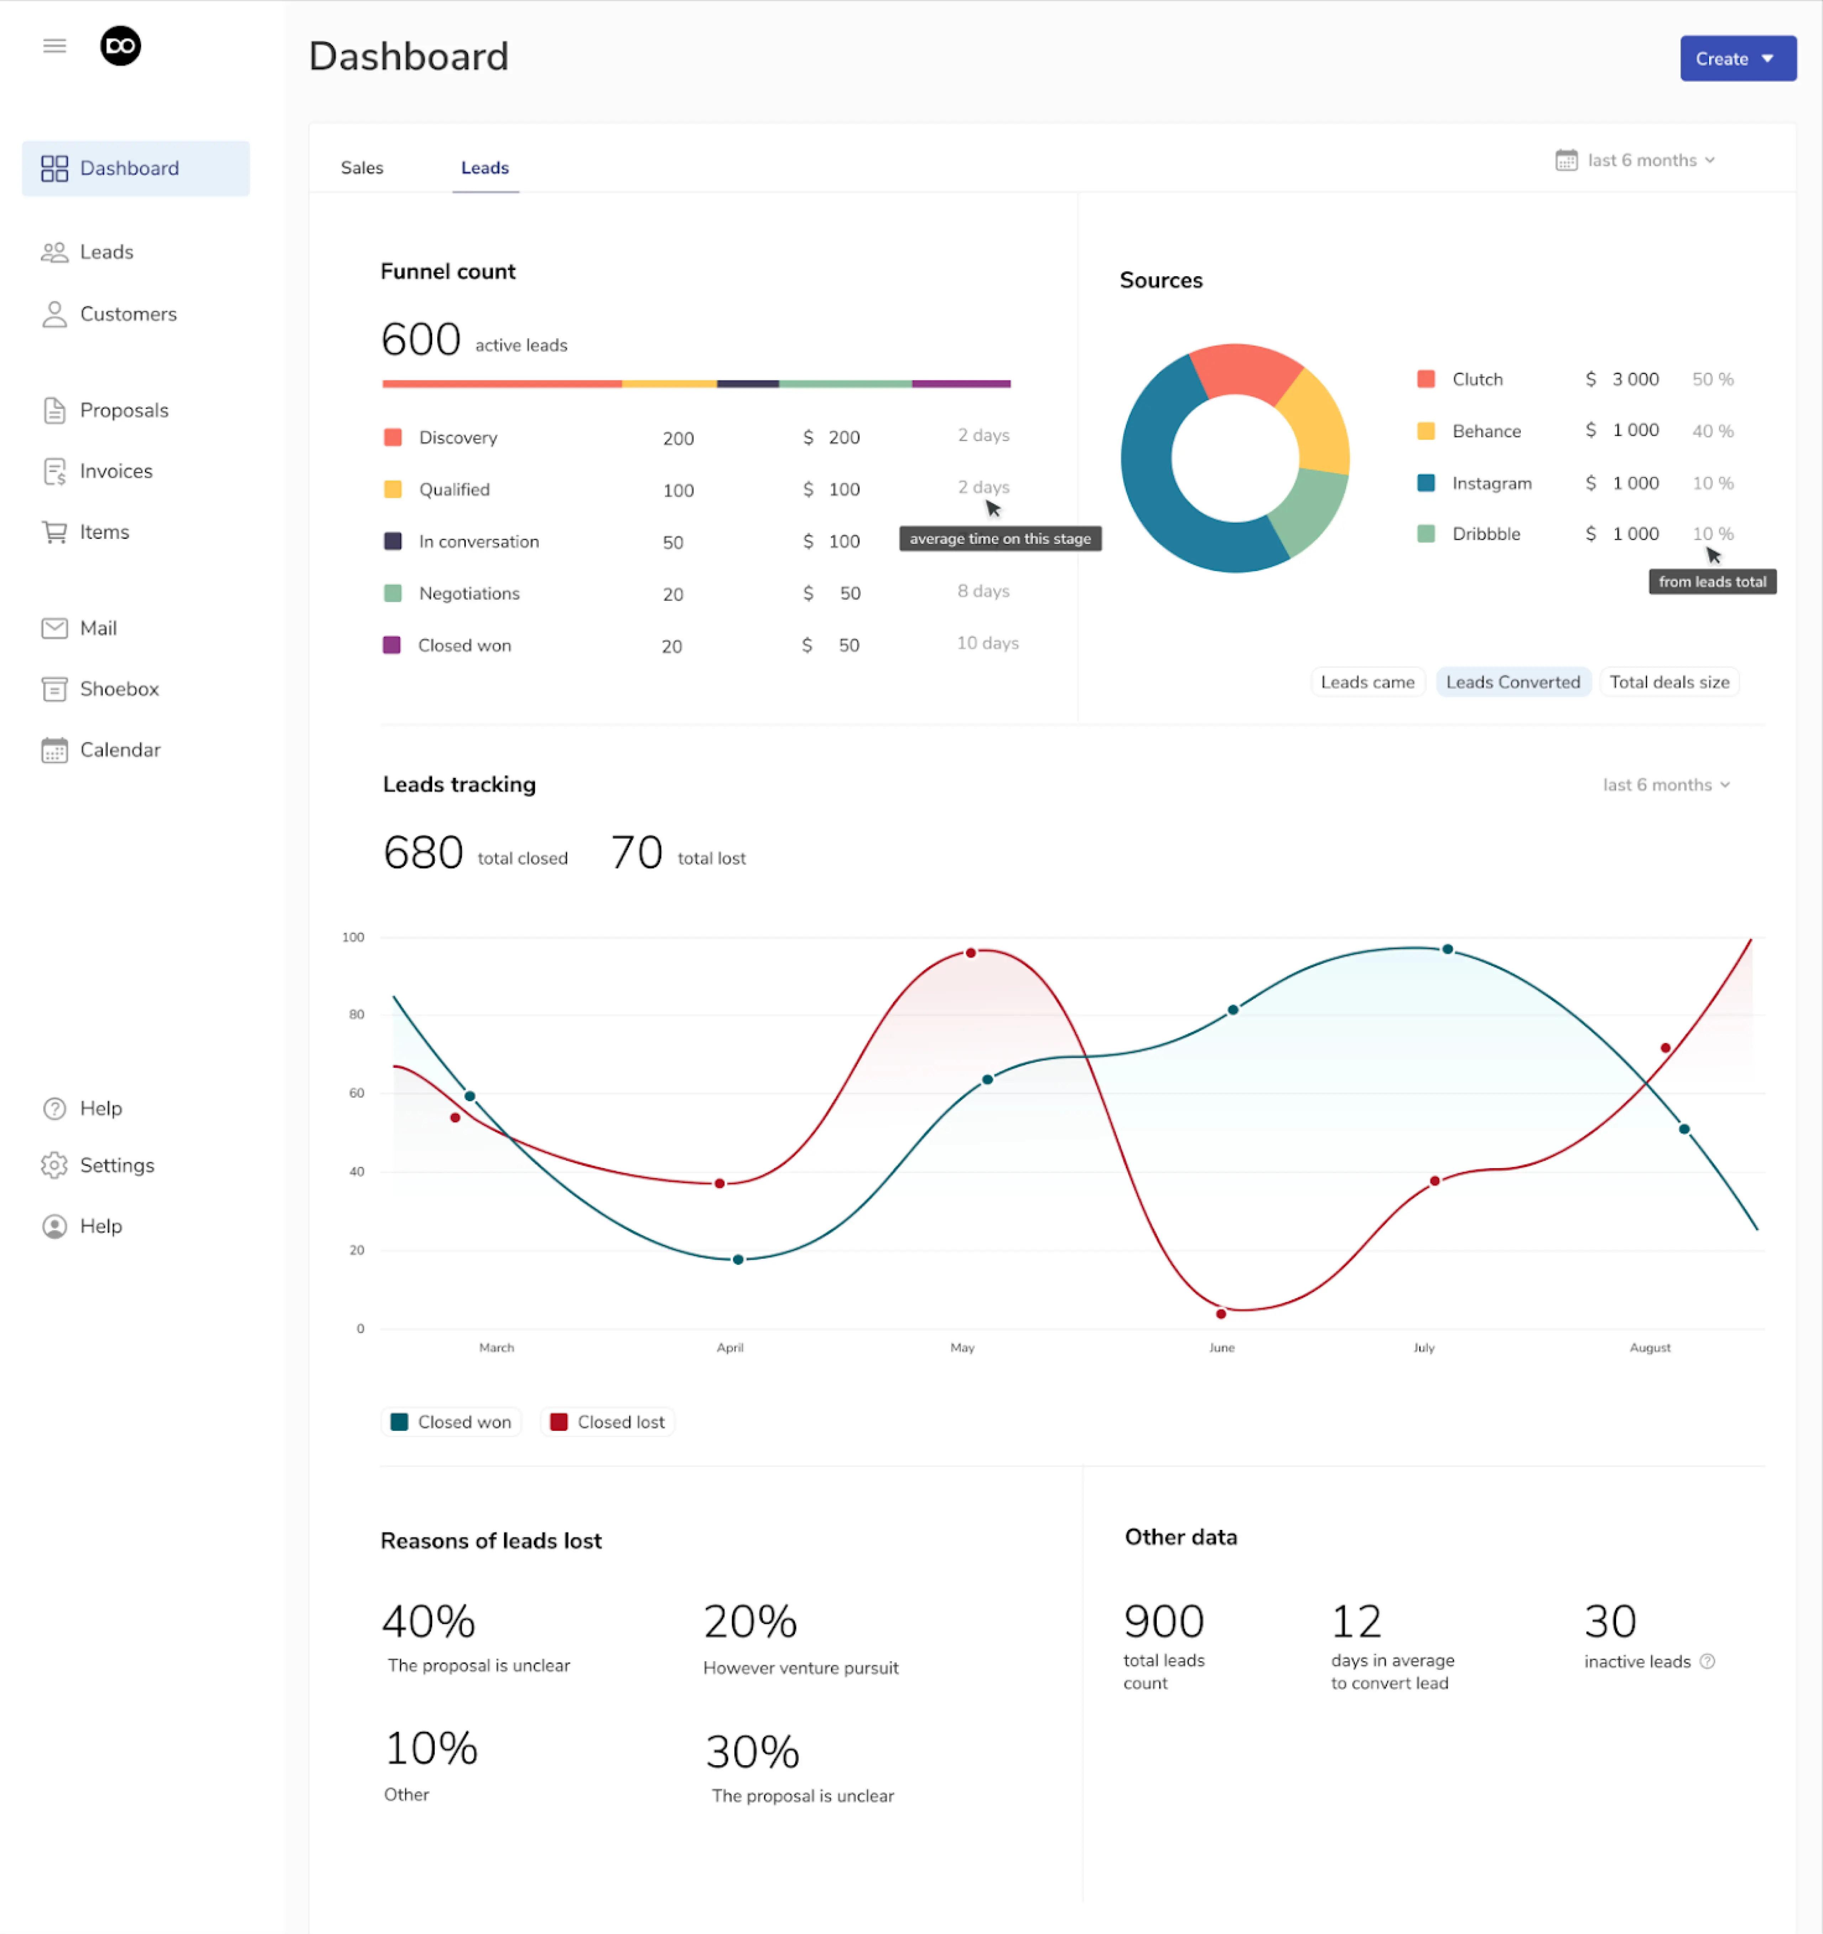
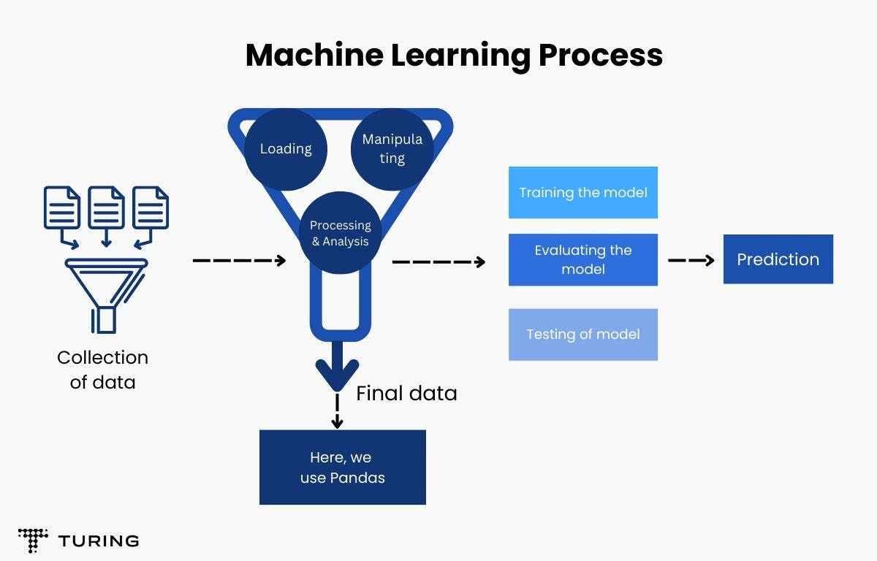
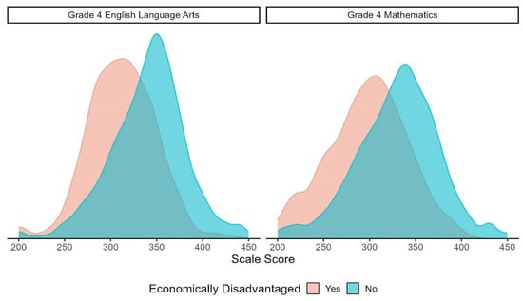

Hook Story:
1. The Challenge: Personalizing Education
2. The Solution: Predictive Tool Powered by Data
3. The Power of Predictive Modeling
4. Exploring Data and Uncovering Insights:-
5. Conclusion: Data as a Tool for Education:-

Slide 5

Hey, I’ve got a new task for you! We have a dataset on student performance, and I need your help in building a predictive model. The goal is to predict math scores for students based on features like gender, race/ethnicity, parental education, lunch type, and whether they completed a test preparation course. Can you handle that?
Absolutely! Sounds like a fun challenge. I'll start by downloading the dataset from Kaggle and get familiar with the features. I'll be using supervised learning algorithms—decision trees, logistic regression, and random forests—to build the model. I’ll make sure to evaluate them based on metrics like accuracy, precision, recall, and F1 score.
Teacher
Data Scientist

Slide 6
Great! Just make sure you also figure out which features are the most important. We want to understand what factors most influence the students' math scores.
Got it. I’ll apply some feature selection techniques to identify those key factors. After that, I’ll tune the models and evaluate their performance. I'll make sure the results are clear and ready to go for your report.
Teacher
Data Scientist

Slide 7
Perfect! Once you’re done, please Demonstrate this on 13 November 2024. Thanks for taking this on!
No problem! I’ll have it ready for you.
Teacher
Data Scientist

Slide 8
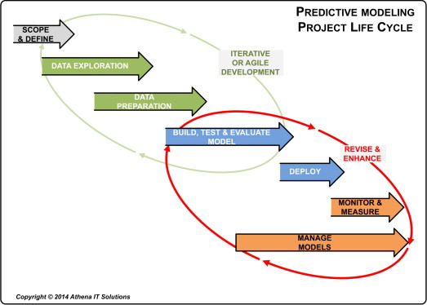
PREDICTIVE MODELING PROJECT LIFE CYCLE

Slide 9
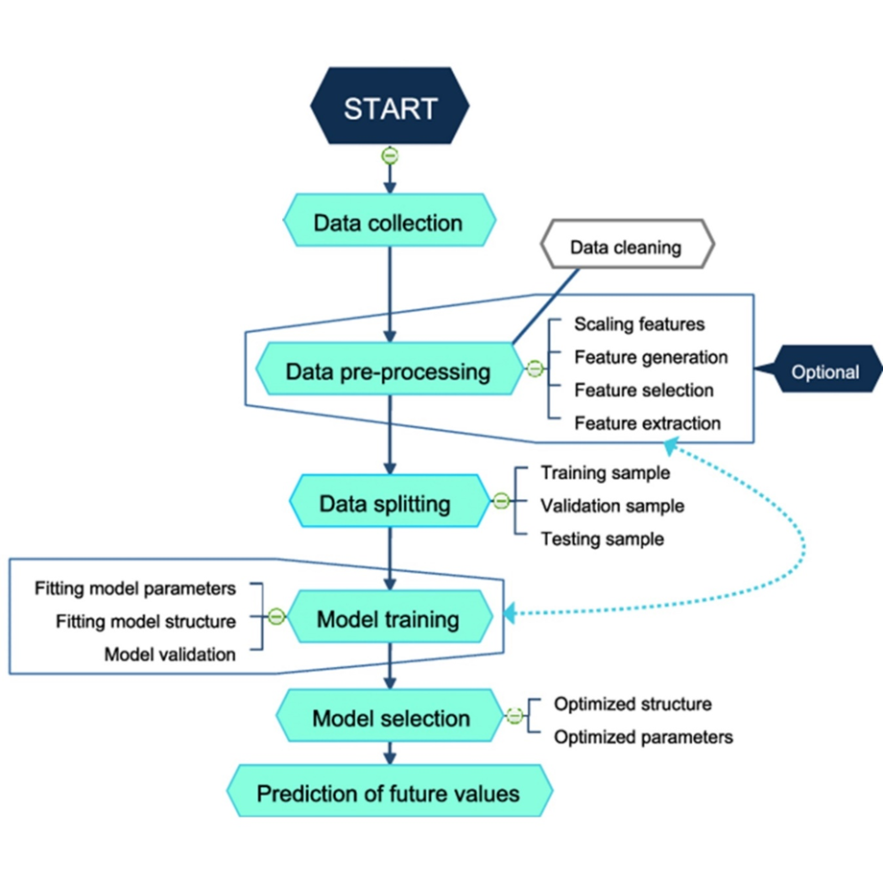
Flow-Chart
Draw by-
Draw.io(software)

Slide 10


Demonstration:-

Slide 11

Conclusion:-
predictive modeling has proven to be an effective tool in identifying the main contributors to student success, with random forests being the most robust model for this task. However, careful consideration of both model interpretability and performance should guide the application of these findings in real-world educational settings.

Slide 12
Reference & Components
For Data-set:-
Student Performance dataset from Kaggle (https://www.kaggle.com/spscientist/students-performance-in-exams)
For Python and Jupyter Notebook:-
https://www.anaconda.com/download
For Presentation:-
https://www.youtube.com/watch?v=LYcOs6kdeTY&t=1602s

Slide 13
THANK YOU

Slide 14
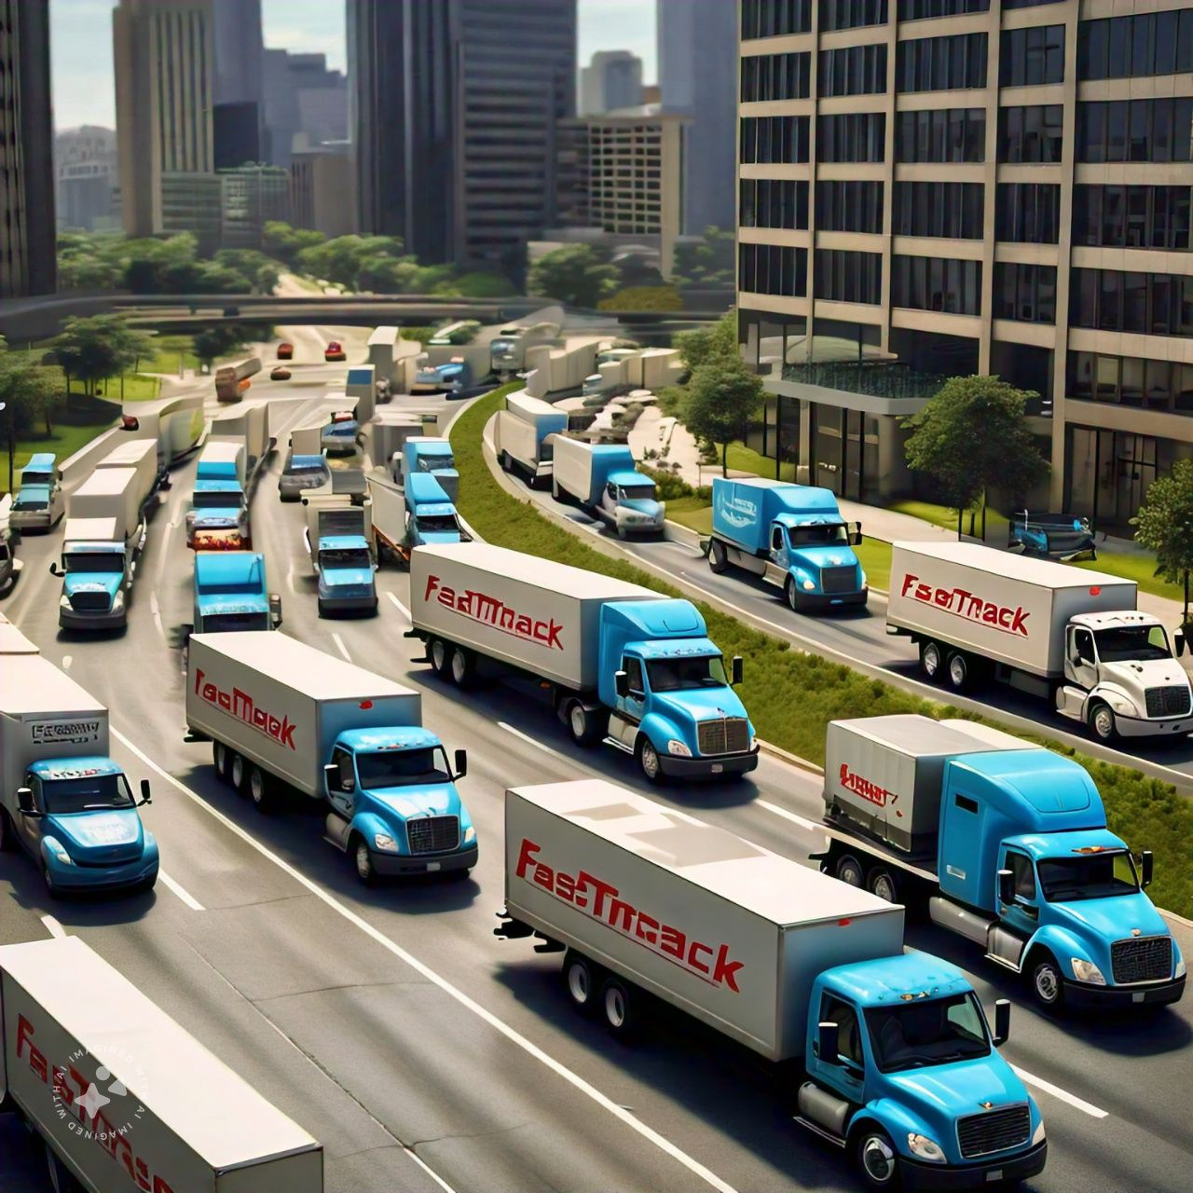
At a logistics company, FastTrack Delivery, business was booming, but so were the challenges. They had hundreds of trucks delivering packages across the city every day. Although they had a general idea of the most efficient routes, traffic jams, weather conditions, and sudden delays often caused delays, leading to late deliveries and frustrated customers.

